Slide 1


Death to the Distributor
sean.feldman@particular.net
@sfeldman

Slide 2

Notes:
Do you know who’s on this picture?
These are some of our customers that are using the Distributor, looking at the brokers and asking the question “why can’t we do the same” on MSMQ?

Slide 3

From Hero
Notes:
The distributor was the hero saving customers with heavy processing messages that would take time and resources on a single server.
It could distribute the processing load across several machines with identical code deployed to all of those.

Slide 4


The Villain
Notes:
But it has its downsides:
1. Throughput limited by the distributor itself

Slide 5


To Villain
Notes:
2. Latency issues contributed by the distributor overhead

Slide 6
To Villain
Scale me
…if you dare
Notes:
3.Elastic scale which is problematic (requires planning and configuration up front). As opposed to brokers, where new instances can just be started.

Slide 7



Distributor Flow
Distributor
Worker | Capacity
Worker 2
0
1
Worker 1
2
Worker 3
3
Worker 1
Worker 2
Worker 3
Notes:
Each worker reports to the Distributor that it’s ready by sending a ReadyMessage. Based on number of threads worker has for processing, that number of ReadyMessages will be sent.
Distributor manages internally information about workers and their available processing capacity.
When an incoming message arrives to the input queue of the distributor, distributor will select a distributor based on information it collected (ReadyMessages) and forward message for processing to the selected Worker. Availability information for the worker will be updated so that distributor won’t send it more work than it can accept. Once the worker is done processing the incoming message, it will report back to the distributor on it’s freed up capacity to process messages by sending another ReadyMessage.

Slide 8



Throughput – divide by 4
Notes:
4 message operations for each business message that needs to be processed

Slide 9

Latency – message chattiness

Slide 10

Small units of work – no benefit
Notes:
For small units of work, the distributor didn’t provide any significant improvement

Slide 11
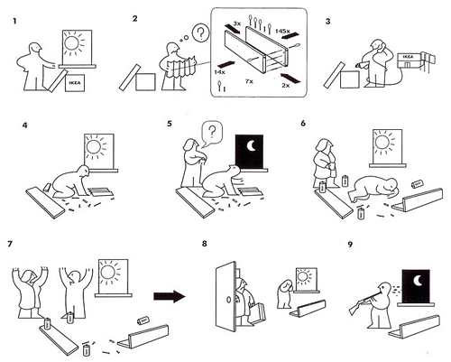

High Availability
Notes:
HA was extremely challenging because it required WINDOWS FAILOVER CLUSTER setup, which as we know as trivial as setting up furniture from a WELL KNOWN SCANDINAVIAN STORE.

Slide 12

Notes:
Eventually distributor hits a limit that it can’t go beyond.

Slide 13

Extreme Scale (Shhh…Our Little Secret)
Bus.Send(“queue@round-robin-server”, message)
Notes:
And what happens when you need the extreme scale out on MSMQ?
Our little secret is – you send messages directly to a specific endpoint.
This forces one to give up on message endpoint mapping that is so convenient.
And instead, taking ownership over message routing and “doing it yourself”

Slide 14

Notes:
You’ve been hanging there for quite a while.
This has been on our mind and we worked on a solution that should make scale on MSMQ a much better story.
You might be thinking “He’s going to announce DISTRIBUTOR 2.0” – NO

Slide 15

Dynamic Routing
Notes:
We call it “Dynamic Routing”

Slide 16

Distributor Node – Gone!
Notes:
No more distributor

Slide 17
Worker Nodes – Gone!
Notes:
No more workers

Slide 18

Robust Control over Routing
Notes:
Complete control over scale-out

Slide 19

Live in Peace with v5
Notes:
Integration with v5 – leave in peace

Slide 20

Infinite Scale…

Slide 21










Legalized: Endpoint and Instances
Notes:
These are now the first class API concepts that allow easy scaleout

Slide 22

Customizable Distribution Policy
SingleInstanceRoundRobinDistributionStrategy
AllInstancesDistributionStrategy
DistributionStrategy => yours to implement

Slide 23


Operation Code: Mini Villain
Bob, do something naughty!
Dun!
Notes:
Gru to Bob: DoSomethingNaughty
Stuart to Gru: Dun

Slide 24

Operation Code: Mini Villain(S)
Do something naughty!
Dun!
Do something naughty!
Dun!
Notes:
Gru to minions (Bob & Kevin): DoSomethingNaughty
One of the Minion to Gru: Dun

Slide 25









The sky’s the limit
Minions, let’s show them!
Notes:
The potential

Slide 26

Are we there yet?
Notes:
I’m sure you’re asking “when can we have this API?!”

Slide 27

Almost
just not yet
Notes:
WHEN public beta is available, beta nuget packages will be published and
we’ll make an announcement to let the world know that the awesomeness is coming

Slide 28

Keep calm: WIP
Notes:
Still Work In Progress
A few rough edges that we’re a polishing. Things to consider are:
Client side routing => Intimate knowledge of the receivers
Requires fast response when a receiver instance goes down (messages in limbo state, and many)
Sender has no way to know if it’s overwhelming a “weak” receiver

Slide 29


Thank You
sean.feldman@particular.net
@sfeldman

